Slide 1
Status of NFPSS MX Beamlines at SSRF
Wenming Qin
National Facility for Protein Science in Shanghai (NFPSS)
/Shanghai Synchrotron Radiation Facility (SSRF)
May, 2024

Slide 2
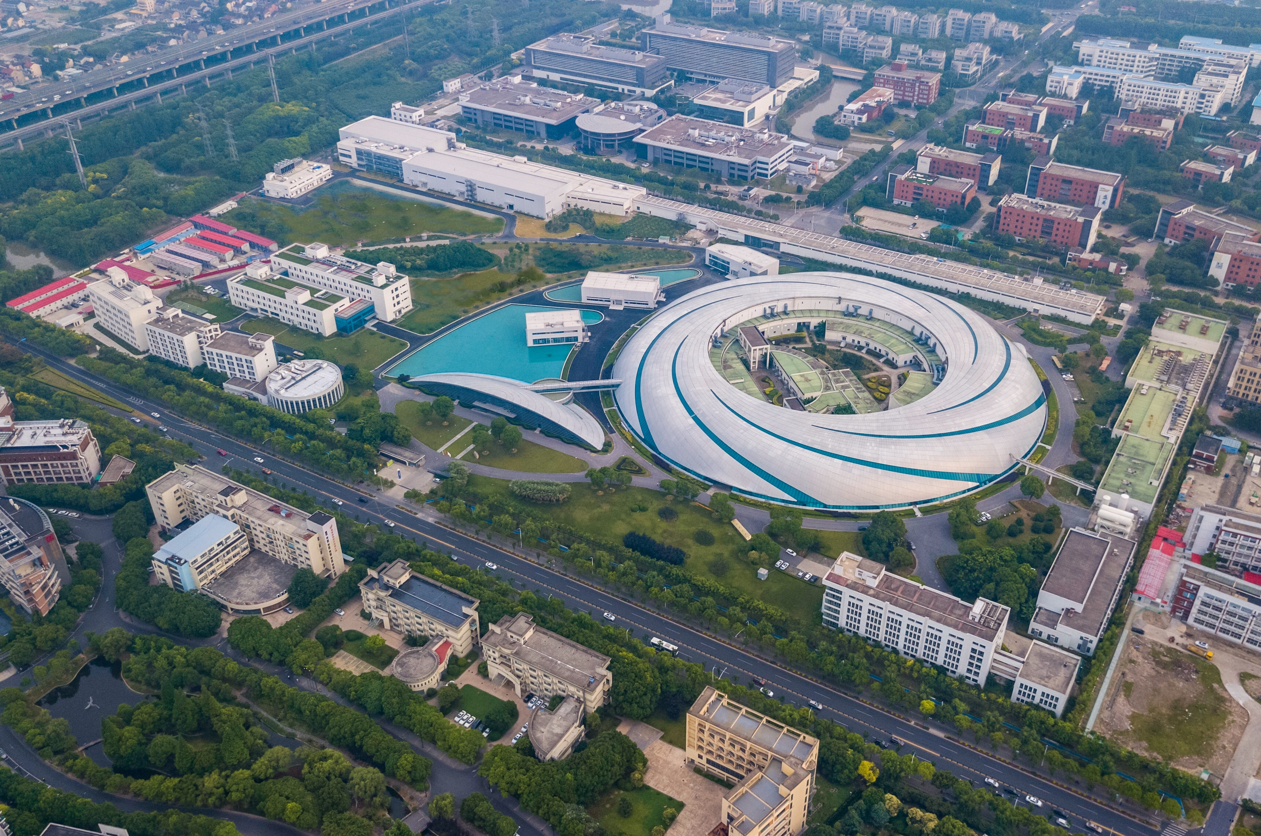
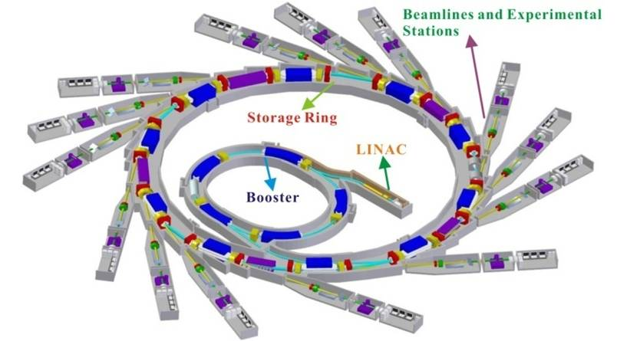
Shanghai Synchrotron Radiation Facility
SSRF Ring Parameters
Electron Energy：3.5 GeV
Electron Current: 300 mA
Circumference: 432 m
Straight sections: 20
Hard X-ray Free Electron Laser
Soft X-ray Free Electron Laser
SSRF

Slide 3

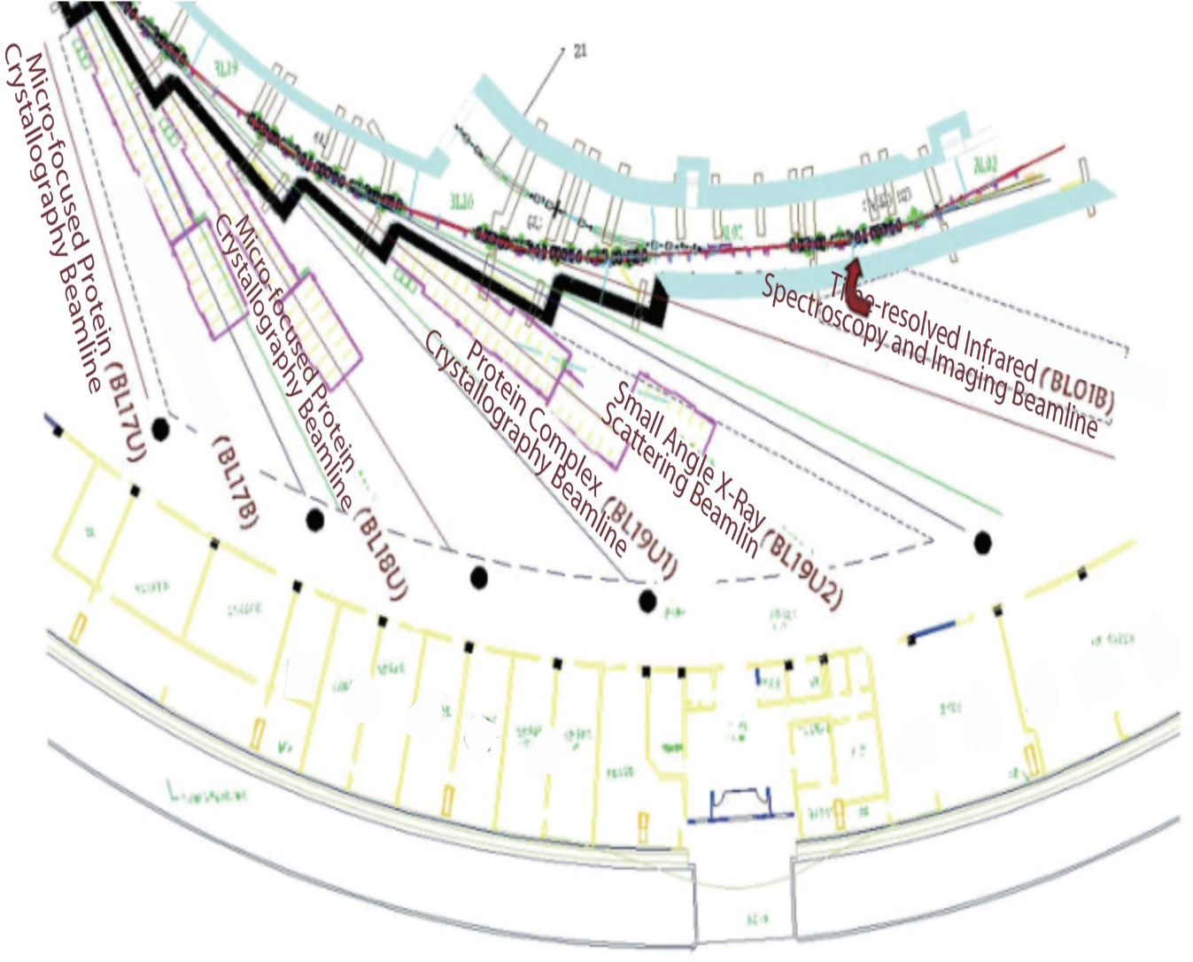
National Facility for Protein Science . Shanghai
NFPS passed the National Acceptance Review, and formally opened to the users in July 2015.
NFPS is composed of 9 technology systems with state-of-the-art instruments in its Haike Road Campus and 5 Beamlines within the Shanghai Synchrotron Radiation Facility.

Slide 4
MX Beamlines at SSRF
BL17B
6 MX Beamlines
BL18U1
NFPSS
MXCube
BL19U1
Shanghai Tech
BL17UM
BL02U1
SSRF
BL10U1

Slide 5
MXCUBE Status
Version of mxcubecore
BL17B : version from 2022.2.23
BL18U : version from 2023.4.9
BL19U1: version from 2023.4.9

Slide 6
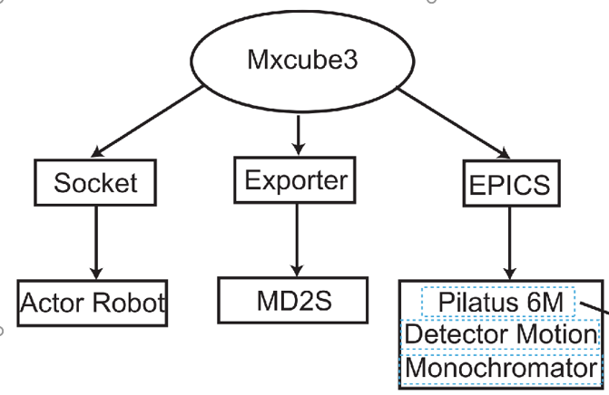
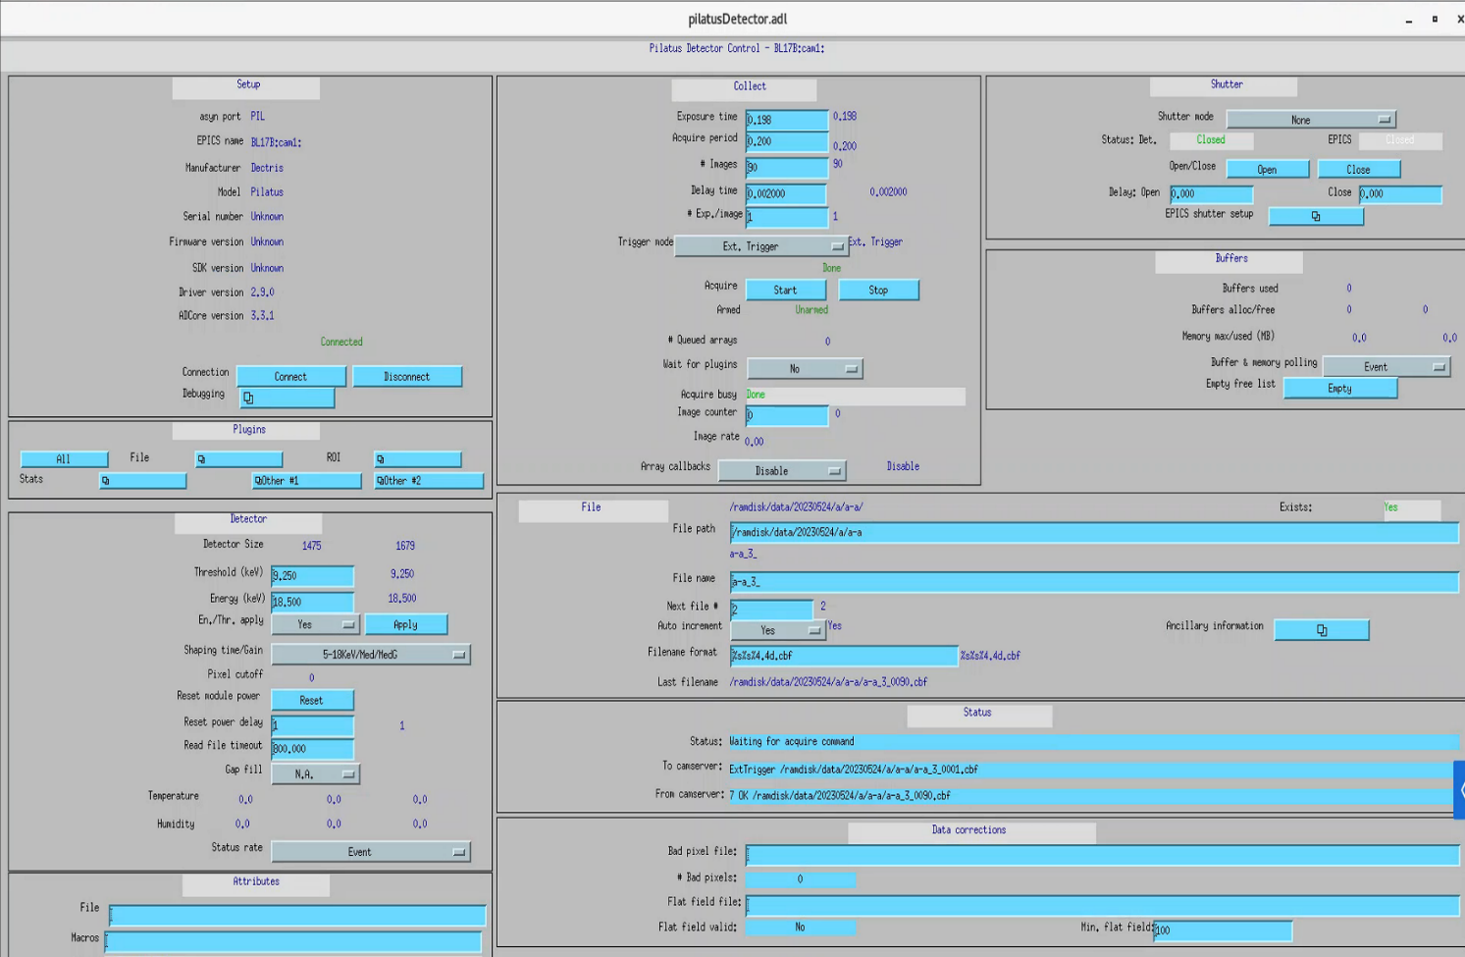
MXCUBE Status
Other development
Integrate Actor sample changer into mxcube
Use EPICS to control the Pilatus detector

Slide 7
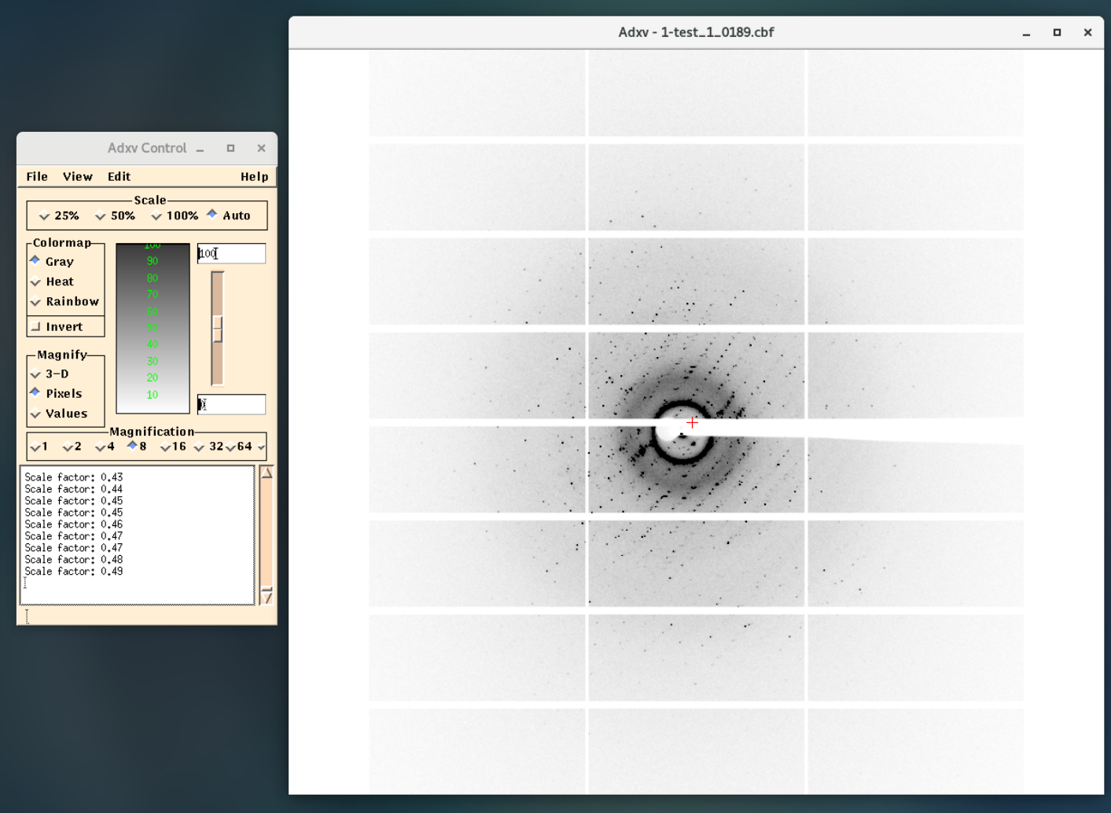
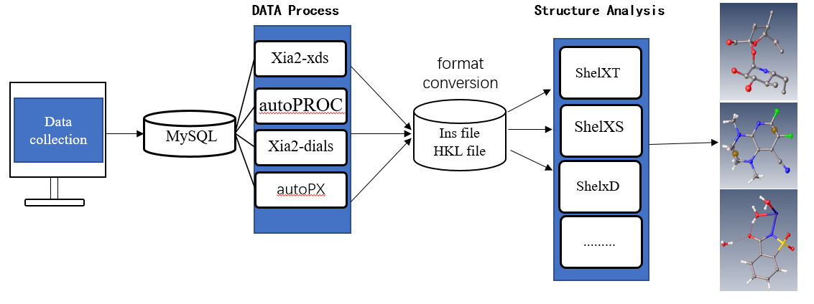
MXCUBE Status
Other development
Auto update diffraction pattern in adxv / Braggy
Deploy four types of auto processing pipeline

Slide 8
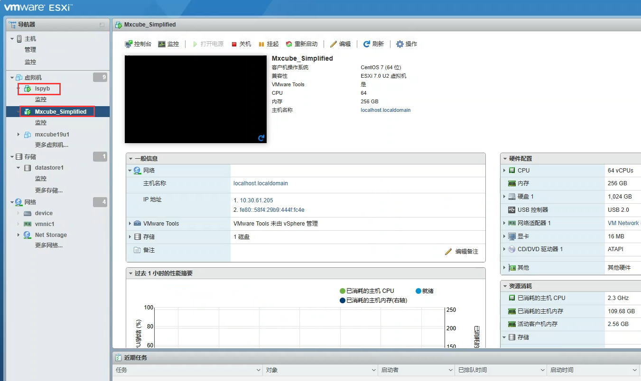
MXCUBE Status
Other development
Use VMware virtual system to run mxcube and ispyb, take snapshot for insurance

Slide 9
MXCUBE Status
Cybersecurity
Most of servers in beamline only connect to the internal network.
Regular backs up users’ data.
Deploy mxcube and ispyb in virtual computer and regular takes snapshot.

Slide 10
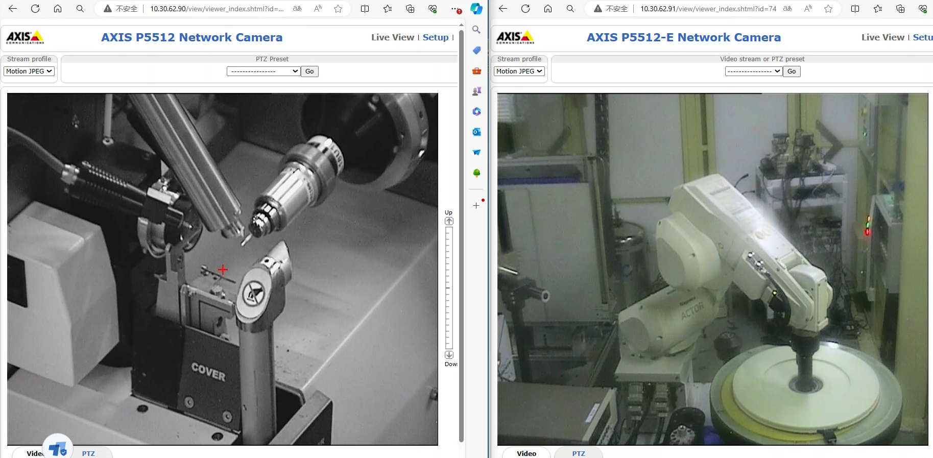
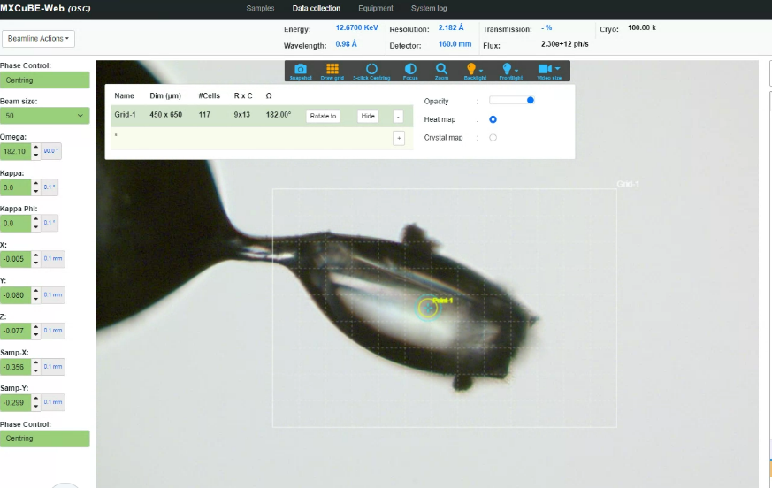
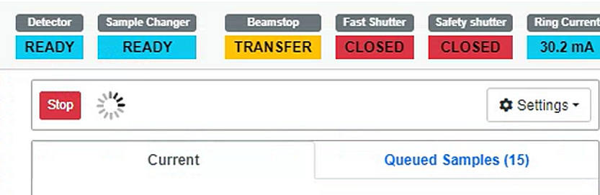
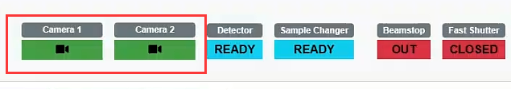
Developments since last meeting
Set up mxcube at BL18U1
Use multithreading to run auto processing pipeline
Configure and make raster scan available in bl19u1
Add monitoring screens on UI （last training course）
Fix bugs such as can not stop the queue

Slide 11
Developments since last meeting
Configuring LDAP for login authentication in mxcube and ispyb.
Completed configuration of ispyb Shipment.
Integrated ispyb into mxcube; data collection information can now be saved.
Configured py-ispyb-ui as the user interface.
Integrated edna2 into mxcube, Characterisation task configuration is complete except for the BEST processing program.

Slide 12
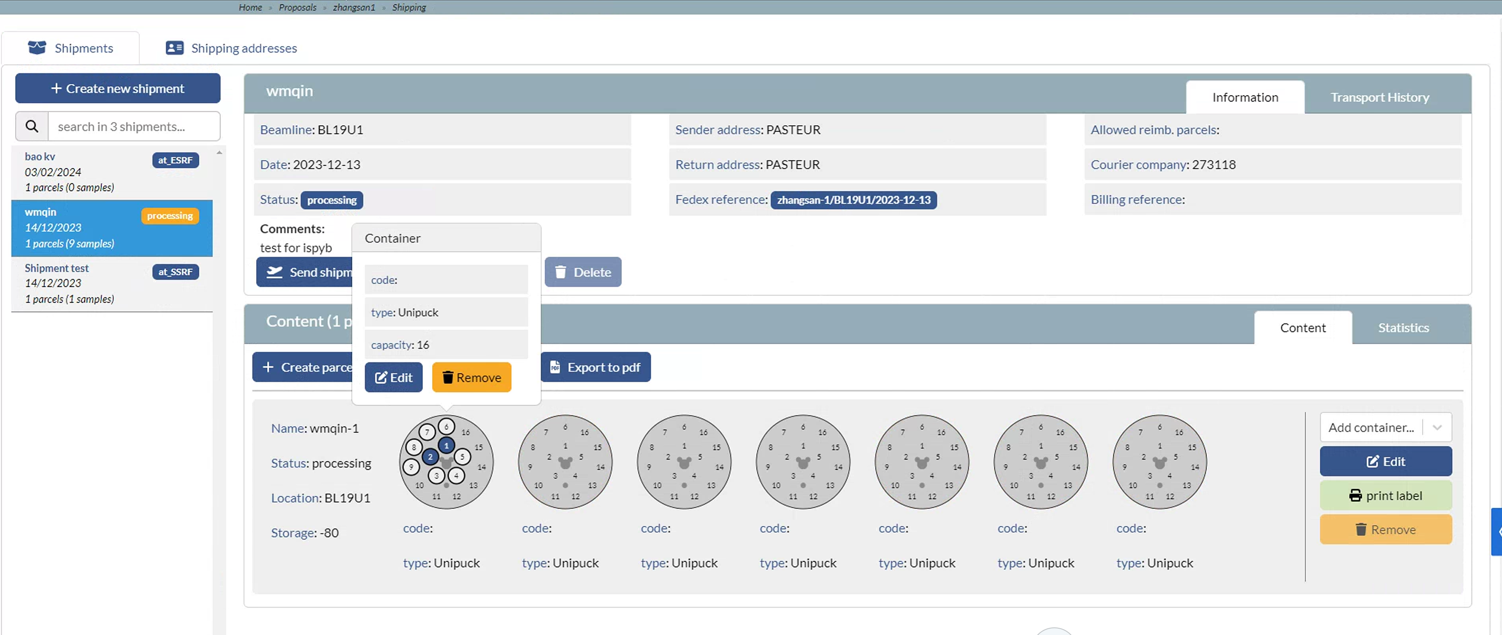
Developments since last meeting
I

Slide 13
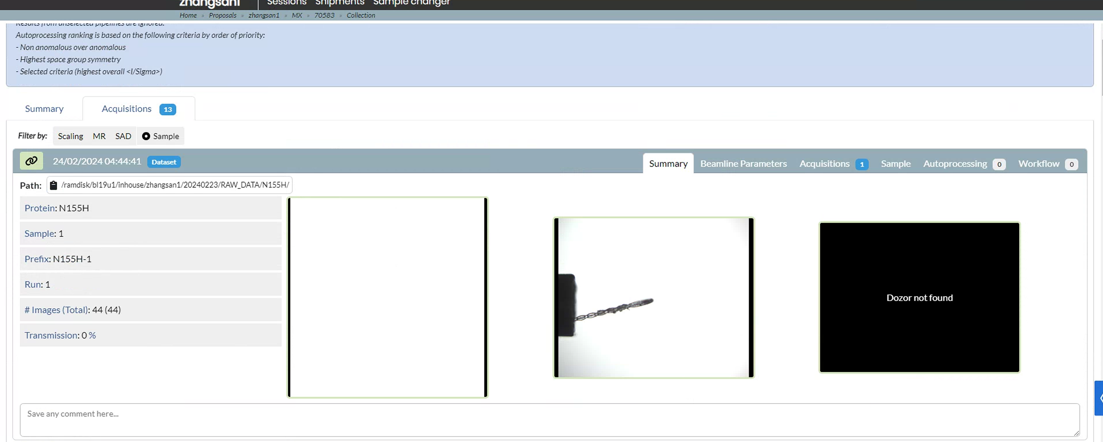
Developments since last meeting

Slide 14
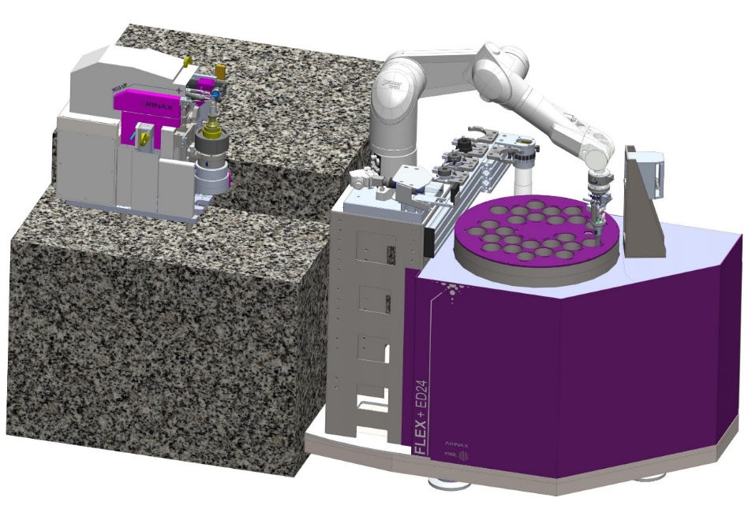
Plans for the next six months
Install FLEX-ED35 from Arinax at BL19U1.
Complete the configuration of ISPyB and connect the database with MXCuBE.
Complete the function of automatic sample mounting, centering and collection.
FLEX-ED35

Slide 15
Question
Are the data collection and processing results saved to ISPyB through offline_processing or online_processing?
Is there a branch of MXCuBE that integrates EDNA2?
What is the function of workflow: ednaparams.xml in beamline_config.yml?
Is the BEST program used by EDNA2 open source?

Slide 16
Thank you for your attention!
Acknowledgments:
- Shanghai Sychrontron Radiation Facility
- Mikel Eguiraun and Jie Nan from MAX IV
-- Letícia G. Capovilla from LNLS
- Arinax, Dectris, Rigaku, Irelec
- MXCuBE community.

